Slide 1
Notes:
Good afternoon. I am Michael Huntington, a retired radiation oncologist from Corvallis. I have no financial interest in presenting my message today other than the benefit that we might all see from a better healthcare system. I am a member of Physicians For A National Health Program.

Slide 2
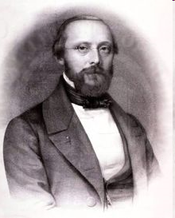
“All diseases have two causes:
one is pathological
the other — political.”
Rudolf Virchow
German Pathologist University of Berlin, 1848
Notes:
In my 30 years working with cancer patients I saw many patients with advanced and neglected cancers. Some of these patients had avoided doctors in spite of worrisome symptoms because they felt they could not afford care. I began to understand that illness can as much a result of politics as biology. The politics of this phenomenon is, “How shall we decide who has access to a healthy life and good health care?” and , “How important is this question?”

Slide 3
Coordinated Care Organizations
How Are They Doing?
Michael C. Huntington M.D.
Oregon Public Health Association Meeting
October 13, 2015
Notes:
In the past five years federal and state legislative actions have tried to address the political causes of illness. Although I feel that a national health program is ultimately needed, the coordinated care experiment is already helping Oregonians and, although many feel that the financial foundation or our CCOs is too frail, CCOs will give us valuable knowledge to help us when we do have a good financial foundation. The other panelist will address how we might achieve that foundation.
In the next 15 minutes I want to provide you evidence that 1. Capitated payments and the CCO model of care delivery can work. 2. The inherently political process of determining who “deserves” care is too costly and confusing. Instead we must have a system with everybody in and nobody out. 3. The public must be allowed to directly oversee the use of its health care tax money and negotiate price with providers and vendors. The current CCO system does not allow this. 4. We owe much to all of the people that have worked to create the CCO system we now have, but it’s up to us to make the CCOs the best they can be at serving the interests of everyone in the state, not just some of us.

Slide 4
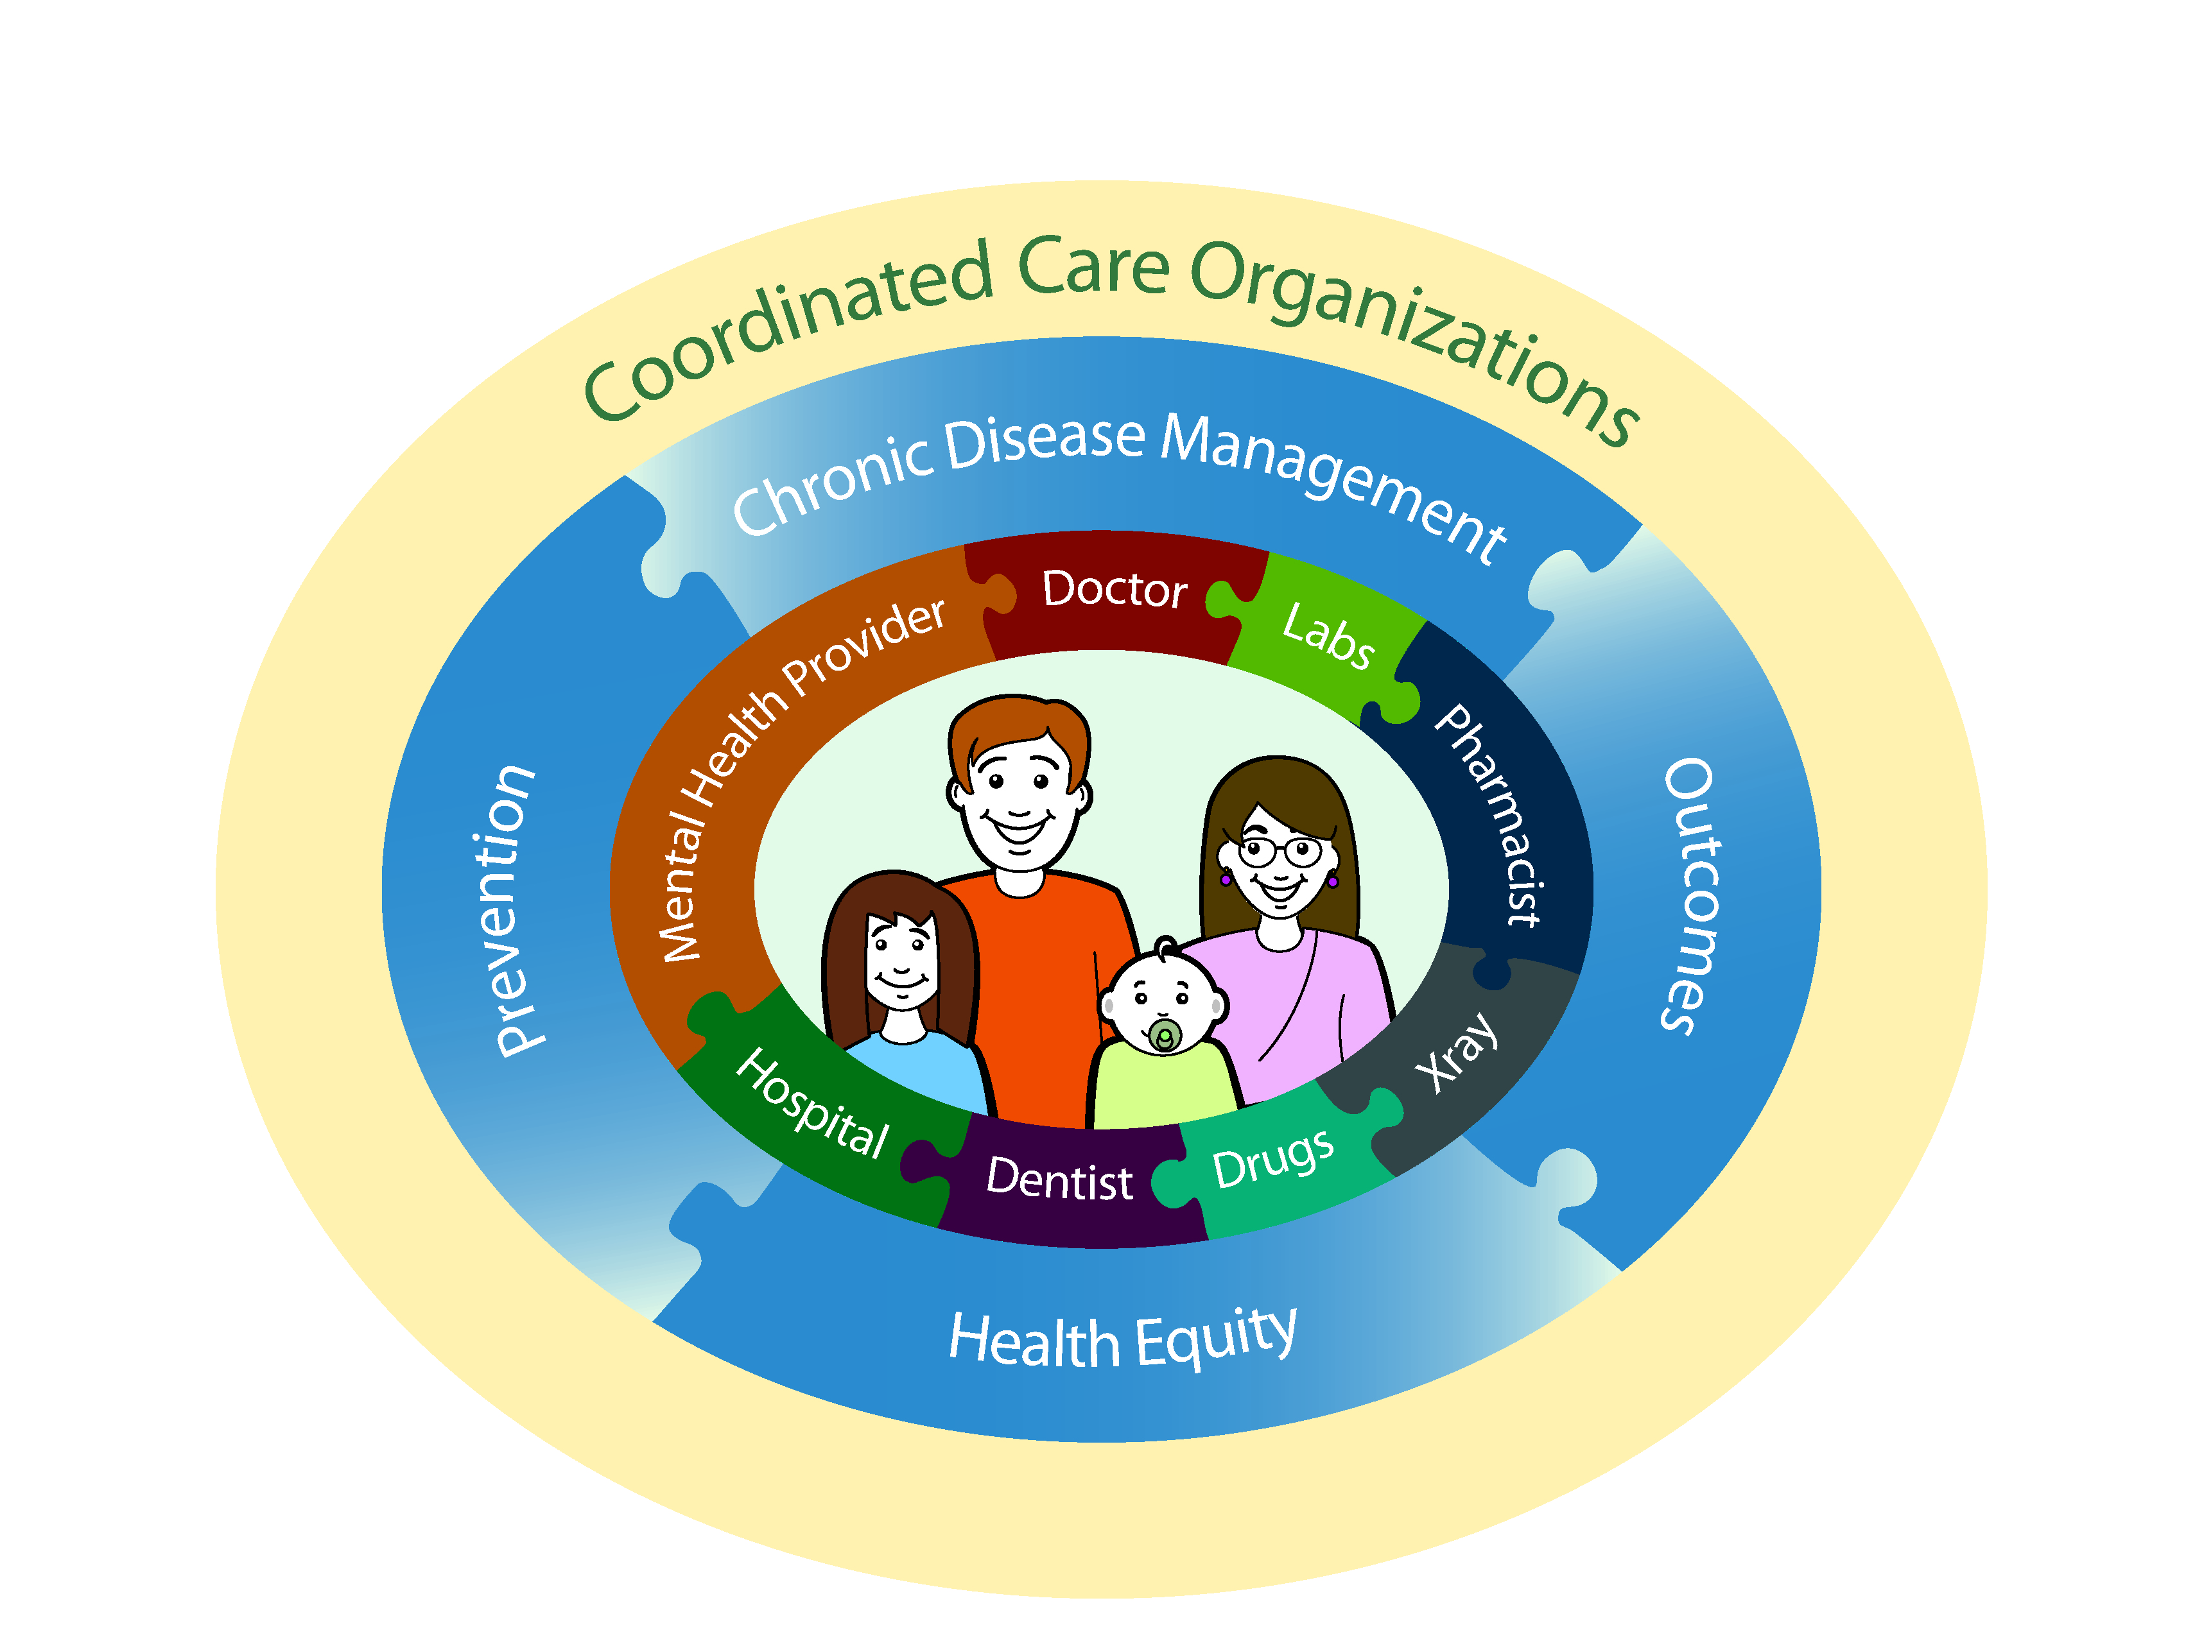
Unified Care
Notes:
*What is a coordinated care organization (CCO)?
Unified care. The care-delivery component of each CCO is the patient-centered primary medical home in which primary care practitioners collaborate with a standardized array of other caregivers under a capitated budget to deliver better care at lower cost. There has been over 80% enrollment of Medicaid patients into PCPCHs since 2012.

Slide 5
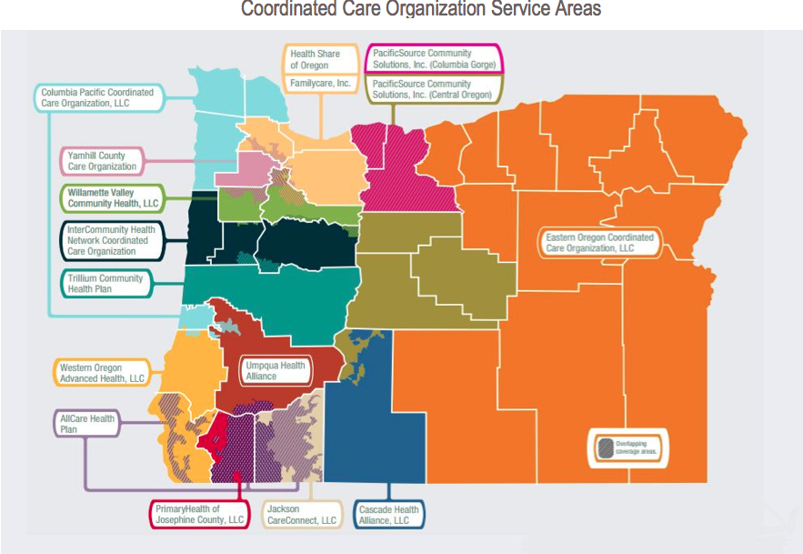
Notes:
*Sixteen CCOs have formed since August 2012, each run by a board composed of local healthcare providers and community members. These boards are advised by a local community advisory council through the chair of the advisory council who sits on the board. However, board meetings are closed to the public. More later about that as a frailty of CCOs.

Slide 6
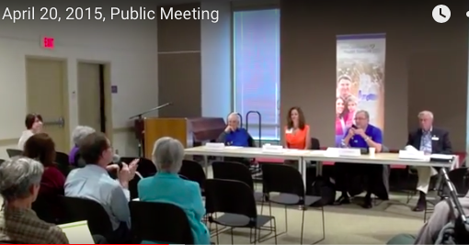
How Are We Doing?
Notes:
*So how are we doing?

Slide 7
17 key healthcare metrics
Oregon Health System Transformation Report
Oregon Health Authority December, 2014
Notes:
Each June the Oregon Health Authority publishes its assessment of performance by Oregon CCOs. ^ Performance is measured based on 17 key healthcare metrics. Benchmarks: unless stated otherwise are averages of the 2013 national Medicaid 75th percentiles for adults and children

Slide 8

CCOs Must be Good Jugglers
Notes:
Integration within CCOs is a tough juggling act. Some CCOs lack executive or operational oversight of member organizations, have potentially competing internal priorities, and have not yet make it easy for patients to access integrated care.

Slide 9
More Insured
Medicaid increases mostly
84%
95%
2011 2014
Gov. John Kitzhaber,
Politifact.com, October, 2014
Notes:
More of us have some form of health insurance now than in 2012. 84%--95%
The 2015 Robert Wood Johnson report says 83% but is using 2012 data

Slide 10

Not Better Access
2014
bench-
mark
88%
83%
83.8%
2011 2014
Notes:
* Access Measure description: Percentage of members (adults and children) who thought they received appointments and care when they needed them.
A home health nurse in Lincoln County I know sees quite a few of this 16%. She spends much of her nursing time begging and battling for her patients in a system that seems not to care.

Slide 11
Patient-centered primary medical home enrollment
51.8%
78.6%
Oregon Health System Transformation Report
Oregon Health Authority December, 2014
Notes:
There has been over 80% enrollment in PCPCH since 2012.

Slide 12
Emergency room use
Per 1,000 member months
2014
bench-
mark
44.6
Lower=
better
61%
50.5%
47.3%
2011 2013 2104
Oregon Health System Transformation Report
Oregon Health Authority December, 2014
Notes:
This is a good trend of decreasing patient visits to emergency departments suggesting more appropriate use of the ER by CCO patients. Reducing inappropriate emergency department use helps to save costs and improve the health care experience for patients.
Benchmark?

Slide 13
Avoidable Emergency room use
Per 1,000 member months
Lower
is
better
14.2%
8.6%
7.4%
2011 2013 2104
Notes:
*Avoidable use of emergency departments was 14%, is now 7% (Lower is better). . Criterion: Rate of patient visits to an emergency department for conditions that could have been more appropriately managed by or referred to a primary care provider in an office or clinic setting.
.

Slide 14
Prenatal Care
2014 bench-mark
90.0%
65.3%
67.3%
82.9%
2011 2013 2014
Notes:
Things are improving in prenatal care with 82% (up from 65%) of pregnant women receiving a prenatal care visit within the first trimester or within 42 days of enrollment in Medicaid.
40 percent of all babies born in Oregon are covered by Medicaid. Timeliness of prenatal care leads to significantly better health outcomes and cost savings.

Slide 15
Early Elective Delivery
2014 bench-mark
2.6%
2.6%
2.3%
10.1%
2011 2013 2014
Oregon Health System Transformation Report
Oregon Health Authority December, 2014
Notes:
This may also be related to better prenatal care.
Percentage of women who had an elective delivery between 37 and 39 weeks of gestation. (A lower score is better so this is a good result).

Slide 16
Congestive heart failure admissions
Per 1,000,000 member years
2014
bench-
mark
264.9
Lower=
better
345.0
294.3
204.8
2011 2013 2014
Notes:
*Outpatient control of congestive heart failure is better by 40%. Criterion: the rate of hospital stays because of congestive heart failure. Benchmark: 10% reduction from previous year's statewide rate 2011 and 2013 data have been updated and may differ from earlier reports.

Slide 17
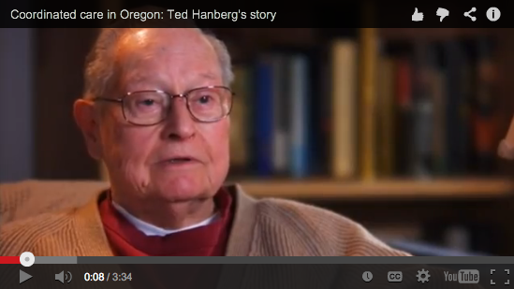
Notes:
* A patient centered primary medical home helped this man control his congestive heart failure. He had been in and out of the hospital many times before the CCO was available to him.

Slide 18
Diabetes HbA1c Control
66%
78.2%
2013 US Medicaid 2014 Oregon CCOs
Notes:
CCOs may be helping diabetics. The 78.2% control rate for HbA1c ˃ 9.0% compares favorably with the 66%. Rate of control that was US Medicaid 75th percentile in 2013.

Slide 19
Satisfaction with care
2014 bench-
mark
89%
78%
83.1%
84.6%
2011 2013 2104
Notes:
*Satisfaction level is the percentage of members (adults and children) who received needed information or help and thought they were treated with courtesy and respect by provider staff.​
Satisfaction level among those who actually gained access to care has improved slightly since 2011 (84.5% vs 78%). The several CCO patients and their doctors I have spoken with are pleased with the PCPMH process.

Slide 20
Hypertension Control
64%
64.4%
2013 US Medicaid 2014 Oregon CCOs
Notes:
*People have devastating strokes from undetected and uncontrolled hypertension. For some this happens because they can’t afford insurance or don’t qualify for Medicaid. I know of two such individuals. But only 65% of enrolled CCO hypertensive patients are getting their pressures under control. Not so good.
There are no earlier CCO data to compare with, but the US Medicaid 75th percentile in 2013 was 64%.

Slide 21
Childhood Immunization
2014 bench-mark
82%
66%
65.3%
67.8%
2011 2013 2014
Notes:
But before and since CCOs only 2/3 of children received recommended vaccines before their third birthday.​ Room for improvement.
Vaccines are one of the safest, easiest and most effective ways to protect children from potentially serious diseases. Vaccines are also cost-effective tools which help to prevent the spread of serious diseases which can sometimes lead to widespread public health threats.

Slide 22
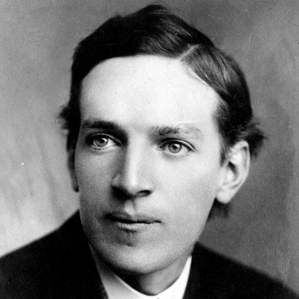
“It is difficult to get a man to understand something, when his salary depends on his not understanding it.”
Upton Sinclair, 1906
Notes:
Upton Sinclair said, 'It is difficult to get a man to understand something, when his salary depends on his not understanding it.’ (Difficult but not impossible).

Slide 23




For profit companies behave the same as non-profit companies
Notes:
Moda and Providence do offer non-Medicaid related CCO models of health insurance to large employers such as the City of Portland and OSU For a subset of high risk employees this managed and preventive care has reduced unnecessary ER visits for people with chronic health conditions.
CEOs of private insurance don’t understand that diverting $40 million of premiums into advertising takes $40 million away from providing health care and the health of our population.

Slide 24
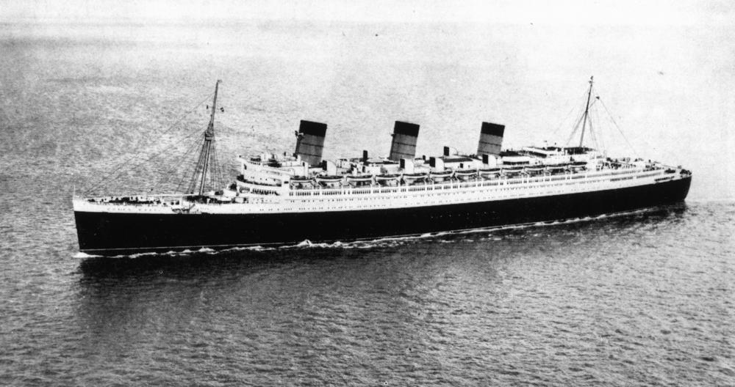
Notes:
*Transformation is slow difficult work - meaningful systems change takes time, like turning ocean liner around when many of the crew members don't know how to and some don't want to turn it around. And of course powerful special interest tugboats keep pulling this healthcare ship toward their harbors.

Slide 25

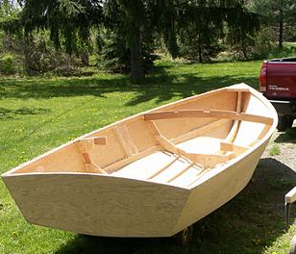
Transition From Old System to New
Notes:
*And it is a struggle to support transformation in care delivery when the dominant incentive is still to do more and charge more. That’s how we still keep our hospital or clinic doors open. The CCO model depends on providing preventive care so that expensive services are not needed and in fact are avoided. One hospital administrator said this transition makes him feel as though he were standing on an old pier that is crumbling while stepping into a new boat which is not yet finished.

Slide 26








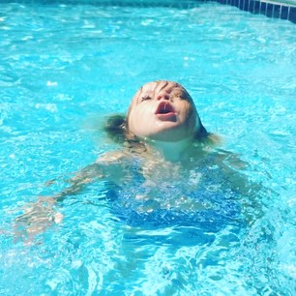
Churning
Oregon.gov/ Addressing Churn… August 2014
Notes:
27% of patients who are initially eligible churn in and out of Medicaid eligibility because of varying incomes year to year. This leads to disruptions in continuity therefore poor quality healthcare. We need a single risk pool in which every resident of the state is eligible for care. http://www.oregon.gov/oha/OHPR/MAC/Documents/2014%20MAC%20Churn%20Report.pdf

Slide 27
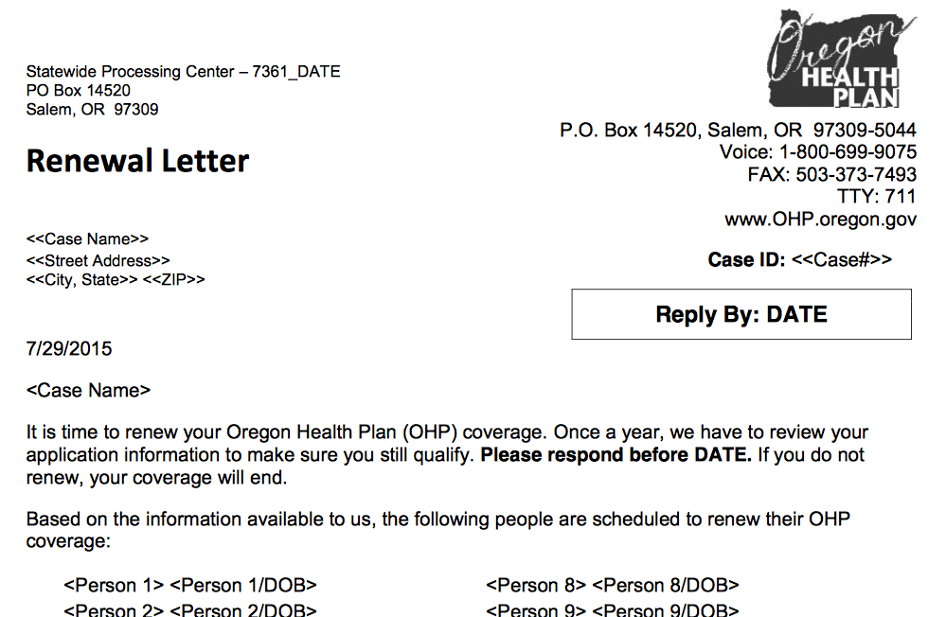

Yearly Reapplication
Notes:
*Yearly reapplication is required because of changes in eligibility. People forget, can’t find required documents, don't understand. They often unintentionally let coverage lapse and are surprised to discover they aren’t covered by Medicaid anymore. More churning.

Slide 28

Financial Problems
$369 M in 2017
$500 M
in 2020
Notes:
Even if Oregon limits Medicaid spending growth to 3.5%/yr as we are obligated to do to keep all of our federal subsidy, the subsidy for the expanded Medicaid population drops from 100% level to 94 percent in 2017 and to 90 percent in 2020. Oregon will have to come up with an extra $369 million per year from 2017 to 2020 and then $500 million/yr after that. Oregon’s annual Medicaid budget is $6.8 billion.

Slide 29
Solutions?
Raise taxes without changing benefits.
Cut other state programs.
Reduce Medicaid eligibility.
Cut benefits.
Notes:
Four options have been tried during Medicaid revenue short-falls in the past.
#1: raise taxes without changing benefits
#2: cut other state programs: police, fire and safety, schools, elderly, infrastructure, transportation
#3: reduce Medicaid eligibility. This immediately reduces state spending — until neglected patients again fill our emergency rooms.
#4: cut benefits. same as above

Slide 30
Other Problems
Notes:
Other Problems

Slide 31





Opaque or Transparent CCOs?
Notes:
Opacity of CCO management. One of the 11 privately owned CCOs, tripled its profits in 2013 after a rapid absorption of Medicaid patients. During the time this CCO was taking in its $300-$400 per member per month Medicaid payments, thousands of its patients ended up depending on safety net clinics because the CCO had too few primary care providers. Safety net clinic workers I spoke with said that the CCO could have hired more providers but had turned down applications from many qualified nurse practitioners and physician assistants.
This CCO is to be purchased by a Fortune 500 company, Centene, of Louisville Kentucky. This is not what most of us had in mind when CCOs were conceived.

Slide 32
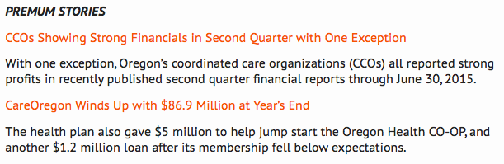
Lund Report, October 13, 2015
www.oregon.gov…Oregon CCO Financial Information
Notes:
This is published today in the Lund Report which you can find online. It shows what you can accomplish with public money behind closed doors.

Slide 33
CCOs try but fail to stem profiteering
Notes:
This cartoon represents the private insurance system. For our current CCO system, the incoming mail from our for-profit system is more bad news: profiteering from private management of public funds. This privatization is happening not only in our Medicaid system but also in the Medicare Advantage system.

Slide 34
Investigate
Find out who sits on your CCO board
Ask for a clear accounting of where the money goes.
  Is it going for convincingly documented care of patients?
  If your CCO doesn’t freely provide information you need, local journalists and your legislators may be willing to help.
Notes:
I encourage you to investigate. Find out who sits on your CCO board by going online to Oregon.gov/CCO governing boards and ask them for a clear accounting of where the money goes. Is it going for convincingly documented care of patients? If your CCO doesn’t freely provide information you need, local journalists and your legislators may be willing to help.

Slide 35
Tell legislators, media, Oregon Health Authority we must:
Keep working on the CCO model of care delivery and capitated payments. This work is vital to the success of any system we devise.
Fight for more public surveillance and power over Medicaid money.
Stop deciding who “deserves” care. The process is too costly. Include everyone.
Notes:
*I think we can say that Oregon's coordinated care organization experiment is starting to succeed and is based on sound principles of providing better care for more people at less cost. But we need major improvements in transparency, oversight, and incentives and we need a single risk pool and unified payer system if the ideals of the CCOs are to survive.
Tell legislators, media, Oregon Health Authority we must:
1. Keep working on the CCO model of care delivery and capitated payments. This work is vital to success
2. Stop determining who “deserves” care and who doesn’t with our complex eligibility schemes. The process is too costly and disruptive. We must include everyone.
3. Fight for more public surveillance and power over how all public money, including Medicaid money, is used.

Slide 36
Tell legislators, media, Oregon Health Authority we must:
Make insurance mean access to health and health care.
Make CCOs serve needs of the public rather than stockholders and the medical industry.
Create a unified coding, payment system with a single risk pool (everyone in).
Notes:
4. Make our legislators create a system in which insurance is not just a card or promissory note but in fact allows access to health and health care.
5. Make CCOs serve needs of the public rather than stockholders and the medical industry.
6. Create a unified coding and payment system with a single risk pool (everyone in).

Slide 37
Oregon's Health System Transformation 2014 Final Report oregon.gov
Kaiser Family Foundation kff.org
Physicians for a National Health Program
Robert Wood Johnson Foundation
countyhealthrankings.org/oregon
Why the Oregon CCO Experiment Could Fail HSS Public Access, 2014
Notes:
These web sites listed on your handout will help you gather and confirm the data you need if you want to help CCOs succeed and achieve better health care for more Oregonians at lower cost.
As we talk with others about health care reform I hope we can listen carefully, honor and allay their fears, and then pivot back to a mutually agreeable goal such as better care for everyone at lower cost. Help the other person see how achieving this goal will benefit them, their family, and their neighbors. It is pretty likely that the person wants all of those people have access to good healthcare.

Slide 38
Health Care For All Oregon www.hcao.org
Mid Valley Health Care Advocates
www.mvhca.org
Physicians for a National Health Program-Oregon
Michael C. Huntington MD
mchuntington@comcast.net
541-829-1182
Notes:
We have indeed come a long way in a very short time, but we have a long way to go. Please investigate these organizations and websites, learn what you can about what’s going on, and rev up your activism for the public good and public health. Here are two organizations that you can look in on and join to put your thoughts into action.

